Slide 1
Supervised Model
Dang Quang An

Slide 2
How to learn efficiently
Practice and practice more
Go to: https://scikit-learn.org/stable/supervised_learning.html#supervised-learning
Practice each example one-by-one

Slide 3
Well-known blogs
For reading papers: https://paperswithcode.com/
NLP: https://ruder.io/
AI blog: https://ai.googleblog.com/ https://deepmind.com/blog
Blog: https://huyenchip.com/blog/
https://blog.feedspot.com/machine_learning_blogs/

Slide 4
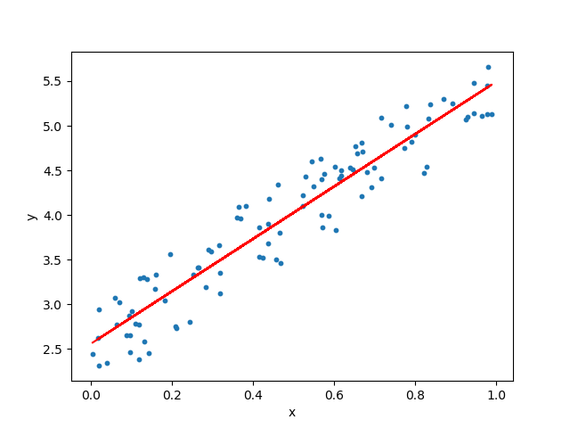
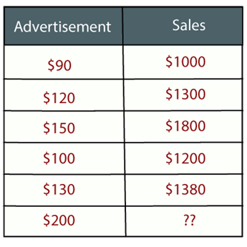
Regression
Regression is a supervised learning technique which helps in finding the correlation between variables and enables us to predict the continuous output variable based on the one or more predictor variables.
For example: Suppose there is a marketing company A, who does various advertisement every year and get sales on that. The below list shows the advertisement made by the company in the last 5 years and the corresponding sales:

Slide 5
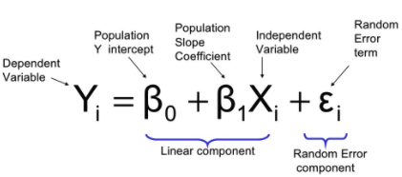
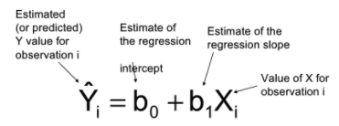
Linear Regression
Outliers: Outlier is an observation which contains either very low value or very high value in comparison to other observed values. An outlier may hamper the result, so it should be avoided.
Multicollinearity: If the independent variables are highly correlated with each other than other variables, then such condition is called Multicollinearity. It should not be present in the dataset, because it creates problem while ranking the most affecting variable.
Underfitting and Overfitting: If our algorithm works well with the training dataset but not well with test dataset, then such problem is called Overfitting. And if our algorithm does not perform well even with training dataset, then such problem is called underfitting.

Slide 6
Linear Regression
Cost function:
Minimize the residual sum of squares between the observed targets in the dataset
RMSE, MAE, MSE
The coefficient estimates for Ordinary Least Squares rely on the independence of the features. When features are correlated and the columns of the design matrix have an approximate linear dependence, the design matrix becomes close to singular and as a result, the least-squares estimate becomes highly sensitive to random errors in the observed target, producing a large variance. This situation of multicollinearity can arise, for example, when data are collected without an experimental design.

Slide 7
Linear Regression
Pros:
Regression estimates the relationship between the target and the independent variable.
It is used to find the trends in data.
It helps to predict real/continuous values.
By performing the regression, we can confidently determine the most important factor, the least important factor, and how each factor is affecting the other factors.
Cons:
Outliers can have huge effects on the regression and boundaries are linear in this technique.
Linear regression assumes a linear relationship between dependent and independent variables.
Linear regression is not a complete description of relationships among variables.

Slide 8
Practice
Advertising data sales (in thousands of units) for a particular product advertising budgets (in thousands of dollars) for TV, radio, and newspaper media On the basis of this data,suggest a marketing plan for next year that will result in high product sales.
Dataset: advertising.csv
Answering Following question:
Is there a relationship between ads and sales?
How strong is that relationship?
Which ad types contribute to sales?
What is the effect of each ad type of sales?
Given ad spending in a particular market, can sales be predicted?

Slide 9
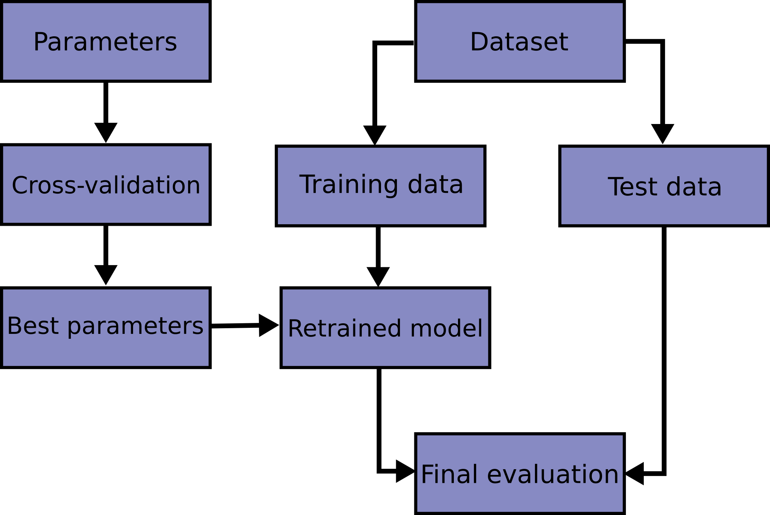

Cross-validation
Learning the parameters of a prediction function and testing it on the same data is a methodological mistake: a model that would just repeat the labels of the samples that it has just seen would have a perfect score but would fail to predict anything useful on yet-unseen data. This situation is called overfitting

Slide 10
Homework
Read the following strategy:
K-folds
Stratified k-fold
Leave one-out
Leave P-out
Applied above strategies with “advertising.csv”. And choose the best strategy

Slide 11
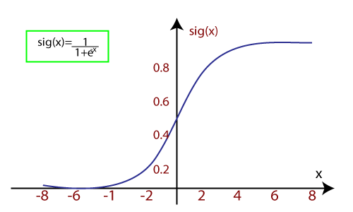

Logistic Regression
Logistic regression is another supervised learning algorithm which is used to solve the classification problems
Logistic regression algorithm works with the categorical variable such as 0 or 1, Yes or No, True or False, Spam or not spam, etc.
It is a predictive analysis algorithm which works on the concept of probability.
Logistic regression uses sigmoid function or logistic function which is a complex cost function. This sigmoid function is used to model the data in logistic regression. The function can be represented a

Slide 12
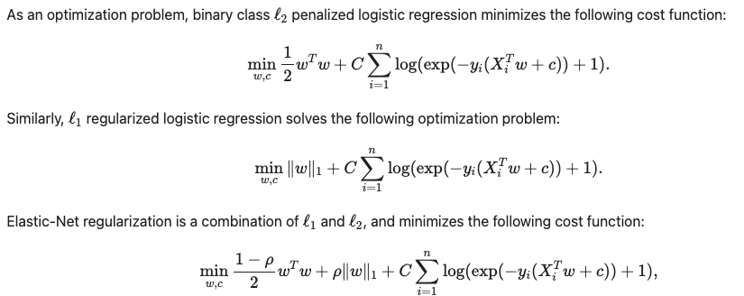
Logistic Regression
Cost function

Slide 13
Practice
(Updating)

Slide 14
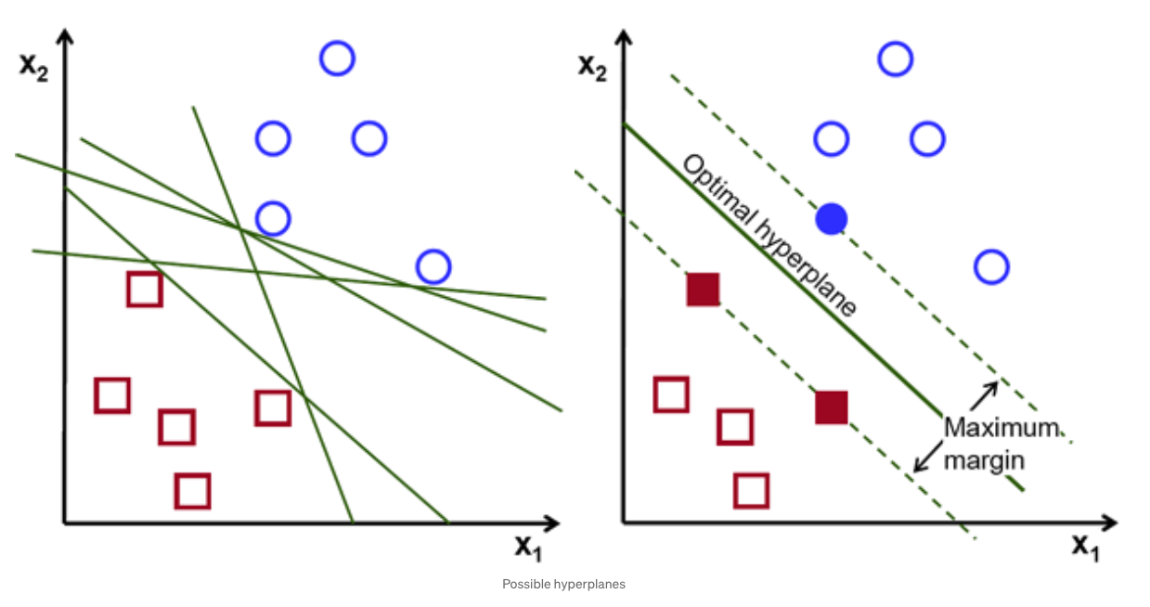
SVM (Support Vector Machine)
The objective of the support vector machine algorithm is to find a hyperplane in an N-dimensional space(N — the number of features) that distinctly classifies the data points.

Slide 15
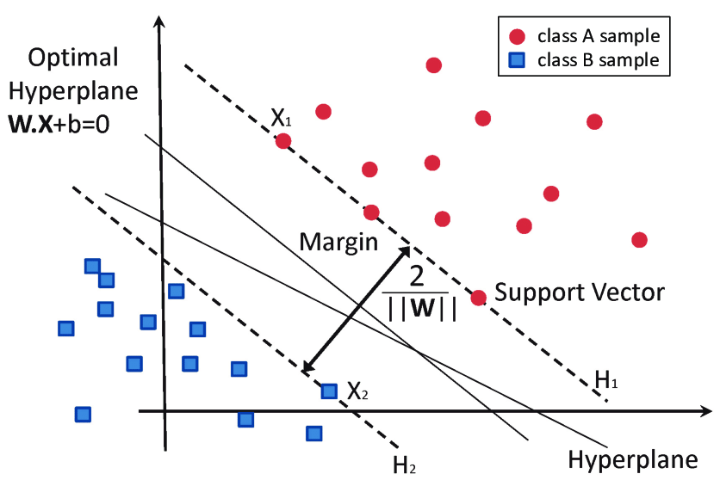
Hyper plane and support Vector

Slide 16
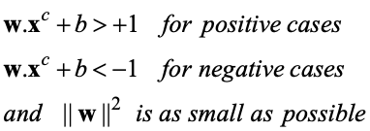
SVM
To find the maximum margin separator, we have to solve the following optimization problem:
This is tricky but it’s a convex problem. There is only one optimum and we can find it without fiddling with learning rates or weight decay or early stopping.
Don’t worry about the optimization problem. It has been solved. Its called quadratic programming.
It takes time proportional to N^2 which is really bad for very big datasets
•so for big datasets we end up doing approximate optimization!

Slide 17
Linear SVM vs Non-Linear SVM
Linear SVM | Non-Linear SVM
It can be easily separated with a linear line. | It cannot be easily separated with a linear line.
Data is classified with the help of hyperplane. | We use Kernels to make non-separable data into separable data.
Data can be easily classified by drawing a straight line. | We map data into high dimensional space to classify.

Slide 18
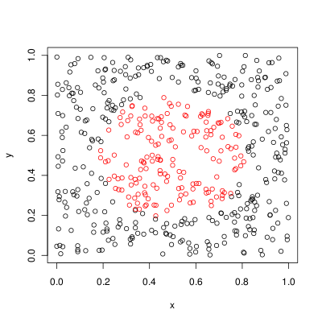
SVM
Can not find a hyperplane that linearly separate data-points.

Slide 19
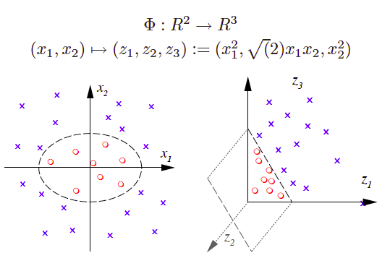
Kernel Function

Slide 20
Exercises
Apply SVM for sentiment classification:
Dataset: tweet1000 csv (1000 documents)
Algorithm: Compare between SVM and Linear Model (accuracy, precision, recall, training time)
Feature extraction : Try both Bag-of-words and TF-IDF.

Slide 21
Homework (continue)
Do you want more Maths in the slides?
Which topics do you want to cover?

